Slide 1
House League Coaches Meeting 2020
September 20, 2020

Slide 2
Agenda
James – Intro and Agenda
Welcome to House League
Intro, Key Contracts – James
Teams, Key Messages, Code of Conduct, Key messages – Zak
Season Overview
General Principals,– Lanna and Lisa
Key Dates, Player Development
Health and Saftey Update - Covid-19 Protocols
Operations – Zak
Referees – Dave Irwin
Communication and Social Media – Lanna
The Gift of Giving Back
Questions
Note: All information is available on www.BGHC.ca under House League Menu

Slide 3
Key Contacts
James - Have a question? Need help?
Here’s who to contact…
General Inquiries - Directors of House League - Zak Lalonde and James Smith
Scheduling - Natalie Hiltz
Referee - Dave Irwin
Rosters, volunteer certifications - Gail Marcos
Webmaster - Herb Chan
Director of Communication and Promotion – Jennifer Wagner
Conflict resolution assistance – Director of Operations – Zak
(No Conveners at this time to report)
Equipment and Safety – Lisa Brown
Name on Jerseys – Chris McMillan Als Source for Sports (arrange after Nov 1)
Off-Ice Apparel - James “Jimmy” Earl at Jimmy Tees
Note: all contacts are found https://bghc.ca/Pages/2138/Key_Contacts/

Slide 4
Coaches
Zak - Who are you?
U11 Coaches:
Kristy Smith, Brad Park, Dave Vrhovnik, Ted Gendron, Pete Mlekuz, Chris Tanner
U13 Coaches:
TBD, Ryan Meeboer, Andrew Lewin, Peter Alcock, Len Collins, Chris Lansdown
U15:
Jim Bordignon, Mark Timar, Paul Patton, Scott Ife, Jason Continenza, Scott Campbell
U18:
Don Richardson, Chris Fulton, Brian Benison, Marion Rabeau, Linda Wright, David Vyse
Note: all contacts are found https://bghc.ca/Pages/2138/Key_Contacts/

Slide 5
Policies & Code of Conduct
Zak - As an appointed coach of the Burlington Girls Hockey Club I pledge to follow the Coaches’ Code of Conduct
I am responsible for my conduct at all times. I will always be a positive representative of BGHC and the City of Burlington.
I will maintain an open line of communication with players and parents. I will explain my goals and objectives for the team, as well as the rules of the game and the policies of the league, to the best of my ability.
I will be reasonable when scheduling games and practices, remembering that players have other interests and obligations.
I will teach my players to play fairly and to respect the rules, officials and opponents.
I will ensure that all players get equal instruction, support and playing time.
I will not ridicule or yell at my players for making mistakes or for performing poorly. I will remember that players play to have fun and must be encouraged to have confidence in themselves.
I will ensure that equipment and facilities are safe and match the players’ ages and abilities.
I will remember that participants need a coach they can respect. I will be generous with praise and set a good example.
I will obtain proper training and continue to upgrade my coaching skills.
I will work in cooperation with officials to the benefit of the game.
I WILL LEAD BY EXAMPLE BY BEING A POSITIVE ROLE MODEL
Change Room & Bench Policy
Absolutely no cameras – Reinforce with all support staff, parents and players
2 Den Mothers required in Change Room
No siblings
Atom & up: men (including coaches) enter room ONLY when an "all clear" given
Note: BGHC Code of Conduct found https://bghc.ca/Pages/2138/Key_Contacts/
House League Rules found https://bghc.ca/Pages/2138/Key_Contacts/

Slide 6
General Principals
Zak – Key Messages about hockey play
Not needed. Game Sheets - Games Sheets will be used for the PHU exhibition Games. Managers, I will send a note out later this week regarding a "pick up" at my house for your team. Details to follow
Refs/Time-keepers - They will be arranged and paid for by the BGHC... Dave Irwin is the Referee and Chief - if the Ref/Time-keeper isn't at the game 10 min prior then call Dave 289 439 7599
Key documents shared …
1) Modified Season Game Tip Sheet
this outlines key areas such as the Modified 4v4 format, COVID protocols, GameSheets, Ref/Time-keepers, Facility Guidelines. Please read in full and share with your team members
2) Facility Attendance forms - used for contact tracing of Visiting Teams
- there are 3 forms: Barracuda, Oakville and North Halton. If you are travelling to North Halton - fill out their form, if travelling to Oakville - fill out theirs.
- Managers Keep the "visiting team" one on file in the event we need to contact trace
These attachments are also located on our https://bghc.ca/Libraries/6011/COVID-19/ page.

Slide 7
General Principals
Zak – Key Messages about hockey play – Ramp
Also, one more EXTREMELY IMPORTANT piece I MUST enforce...OWHA isn't messing around this year. You MUST have your certifications/respect in sports/police check entered in RAMP. In the past, Gail (CC'd) was able to subvert the system temporarily until you got them, but with the move to RAMP she cannot. Once submitted to the OWHA office (RAMP does that directly) and approved by them, you have 30 days to ensure all criteria is met, and if it's not, your team gets voided and pulled.

Slide 8
General Principals
Lanna - General Principles for the season format:
Calendar is up to date on the site with the schedule - team # and Colour are there
https://bghc.ca/Leagues/1524/Calendar/
1) Internal and External Groups
- according to the OWHA we are allowed to form Internal Groups and External Groups or Bubbles of 50 players.
- Each division (U9, U11, U13, U15 and U18) are split into 6 teams and form up 2 Internal Groups/Bubbles
Internal Bubble 1: Team 1, 2, 3 (colours yet to be determined) and Internal Bubble 2: Team 4, 5, 6

Slide 9
General Principals
Lanna - General Principles for the season format:
2) Goalies
- each Goalie will be assigned to a specific team within 1 Internal group/bubble, this would be for Practices and Games within that Internal Bubble
- BUT because we don't have enough for each team, Goalies will also be part of an Extended Group
- due to their limited contact with other players, not sitting on the bench etc this risk factor is low for contracting COVID so they can also belong to the External Group (the other group of 3 teams)
- This External group is for GAMES ONLY
- this would be discussed prior to each game to ensure they are available to play back to back and if parents are ok with this happening for their daughter
- we have enough for 1 Goalie per Internal Bubble, but in some cases (U9, U11) we have only a few so this External Group/Bubble rule will be needed to take affect for Games

Slide 10
General Principals
Lanna - General Principles for the season format:
3) Schedule Rotation
- weekly schedule is as follows - each team is on ice 4 times over 3 weeks (U18 is only games so replace "practice" with "play"
- Week 1 (starting tomorrow Oct 17)
- Team 1 practices Team 2, Team 1 plays Team 3 / Team 4 practices Team 5, Team 4 plays Team 6
Week 2
- Team 2 practices Team 3, Team 2 plays Team 1 / Team 5 practices Team 6, Team 5 plays Team 4
Week 3
- Team 3 practices Team 1, Team 3 plays Team 2 / Team 6 practices Team 4, Team 6 plays team 5
then repeat for then next weeks 4,5,6,7,8,9,10
4) Teams for Games
you will NOT have split teams for Games -
New Rules. No Games
- as we have rosters of 13 or less we are able to abide by the facility and on ice rules

Slide 11
General Principals
Lanna - General Principles for the season format:
5) On Ice # of people
- OWHA states 30 people on the ice
- Practices - each team of 13 players or less + 2 coaches and goalie X 2 teams = 30ppl. we have tried to make the teams of 13 only in a few cases so the 30 rule wont go over
- Games - each team of 13 players or less + 1 coach + 1 or 2 refs (depending on division) = 30. Trainers/time keepers are not part of ON ICE,
- Trainers are to be off the bench to the side door - you can have 1 for both teams to help rotate through and limit # of people at each practice / game
- if you have less players coming to the game you can have another coach. (you can have a coach support to the side off the bench to the side of the door if needed as well)
6) Facility # of People
- City of Burlington state 50 people in the arena
- Practice or Games - 30 people on ice (players/coaches) + trainers. so the remaining OFF ICE makes up your 50
Spectators make up this remaining 50 so its approx 1 parent per player –
but if the trainer/coach is a parent then we recommend not to have another parent for that player present to allow other families to be there

Slide 12
General Principals
Lanna - General Principles for the season format:
7) Benches
- 6 players to sit on bench + 2 coaches to stand
- if you have more players then 6 they can be to the side of the door by the bench (with the trainer)
- as stated - if you have less players then 11 in total (4 on ice, 1 goalie, 6 on bench) then you can have more coaches on the bench as needed
8) Change Rooms
- you will be provided 2 change rooms per practice / game
- most rooms can hold 5 or 6 ppl - #s posted on the door
- 1 team gets 1 room, other team get other room
- rooms MAY be posted on the lobby screen, but best way to know is checking the "unlocked doors" as 2 will be left unlocked for you each ice time
- bags can be left in room
- skate tying chairs / locations are in both arenas so try and have your players arrived dressed and use these spaces to finishing dressing / skate tying and bags can be left there too
9) Game Sheets
- Zak / Dave Irwin (ref and Chief) have created a "game sheet" for you to fill in and give to the time keeper for each game
- its attached and also found on https://bghc.ca/Libraries/6011/COVID-19/ our COVID resources site

Slide 13
Covid-19 Protocol
Lisa - BGHC Health And Safety ; Covid-19 Protocol
BGHC Health & Safety
During these times of uncertainty, the planning and preparation of the BGHC Return-to-Hockey Plan has been top priority.
We have posted principles representing our approach to developing a clear and effective plan that will once again bring our players together on the ice.
Key Links
https://bghc.ca/Pages/6025/Covid-19_Protocol_FAQs/
https://bghc.ca/Libraries/6011/COVID-19/
Concussion Guide - https://bghc.ca/Pages/2147/Safety_Concussion_Resources/

Slide 14
Covid-19 Protocol
Lisa - BGHC Health And Safety ; Covid-19 Protocol
BGHC Health & Safety
Masks must be worn at all times unless on the ice
Coaches and trainers must wear masks while on the bench
Coaches may remove their masks when on the ice, but ensure proper distancing from players
TeamSnap
Contact tracing is essential to the success of our programming
All players, coaches and staff must complete a health screening prior to entry at the rink
Entry will be denied if a health screening is not completed or is failed
Team manager must remain at the entrance of the rink to enforce health screening status and access to the rink
Parents must be added as non-players and complete the health screening if they plan to enter the rink to watch practice/games. Access will be denied if they have not completed a screening.
TeamSnap Health Check Guide –
https://bghc.ca/Libraries/6011/COVID-19/

Slide 15
Important Dates & Schedule
Lanna – Key Dates
The season will be broken into two sessions.
The first session will begin on October12 ending December 20th
The second session will run between January - April
October
Waivers Due - ?
November
No Team Photo Day planned
December
23rd to Jan 1st – BREAK - Christmas
February
TBD – Playoffs ?
Feb 17th – BREAK – Family Day
March
14th to 22nd – BREAK – March Break
28th & 29th – Championship WKD
April
4th & 5th – Queen of the House
Note: all dates are found https://bghc.ca/Pages/2139/Key_Dates/

Slide 16
Support Staff & Certification
Zak It takes a village to run a team…so ask for support!
The BGHC will reimburse for certification fees!
https://bghc.ca/Forms/1054/Volunteer_Reimbursement_Request/
As a Head Coach you require:
Coach 2 (for IP Coach 1)
Respect in Sport (RIS)
Police Check (valid within 3 yr)
Manager
Certification - Valid Police Check
Role:
Complete Roster/waiver
Book Tournaments and hotels
Game Sheets collection / submission
Ensure Refs arrival at games
Supports team communications
Assistant Coaches (1 +)
Certification - RIS and Valid Police Check
Role:
Positive reinforcement to players
Support in practices and games
Trainers (min 1)
Certification - RIS, valid Policy Check & HTCP
Role:
On bench for health/safety
Enforce concussion protocol
Note: Certification requirements found https://bghc.ca/Pages/2003/Volunteer_Certifications/

Slide 17
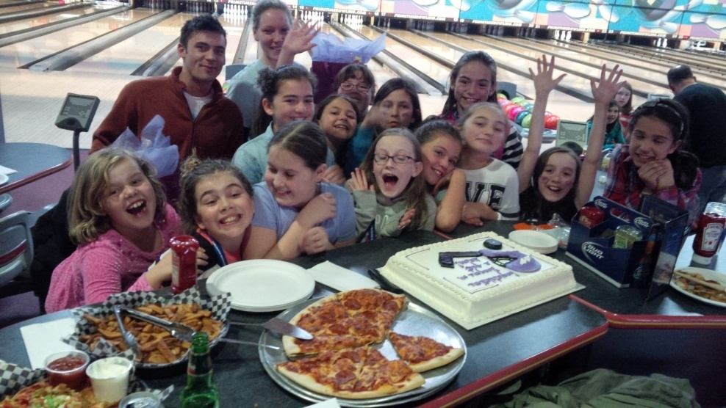
Parent & Player Interaction
Zak - Set expectations and keep FUN at the centre of everything
With your Parents:
Discuss Code of Conduct
Direct concerns to Division Convenor or Director
Use the 24 Hr rule
Discuss your coaching philosophy – ie.
“creating a fun, memorable, and occasionally very meaningful, lasting moments for players, regardless of skill level, and regardless of team wins and losses”
With your Players:
Organize team social events
Player of the game award
Music in dressing room
Create team name, signs, cheers, mascot
Wear your Cuda colours (Jimmy Tee’s)
Note: HL start right guide found https://bghc.ca/Public/Documents/HL_-_Season_Start-Up_List.pdf

Slide 18
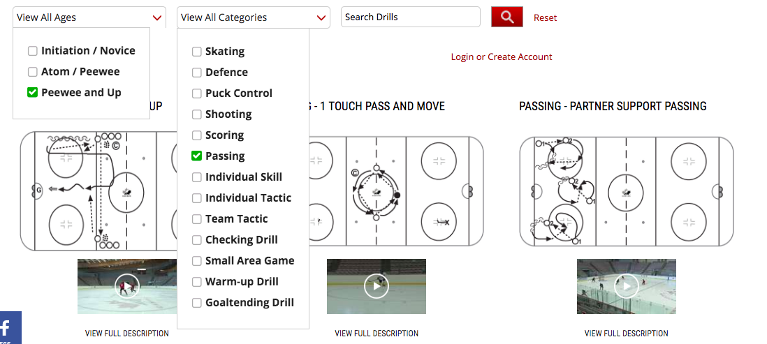
Coaching Support
Zak - Follow Hockey Canada Guidelines and utilize the resources available to create practices, lead successful games and develop your players
Hockey Canada Drill Hub includes:
Free resource for all coaches
Age/Division specific resources
Practice Plans and Skill Manuals to print & share
Videos featuring Canada’s National Women’s Team
NEW! IP and Novice specific support
Coaches Corner on the Website
Female coaching clinics with Jana Harrigan (ask about it if interested)
Link to Hockey Canada “Drill Hub” https://www.hockeycanada.ca/en-ca/hockey-programs/drill-hub

Slide 19
Referees
Dave Irwin – Message from Referee & Chief
If your Ref has not arrived within 20 minutes of Game Start time call Dave 289-439-7599

Slide 20
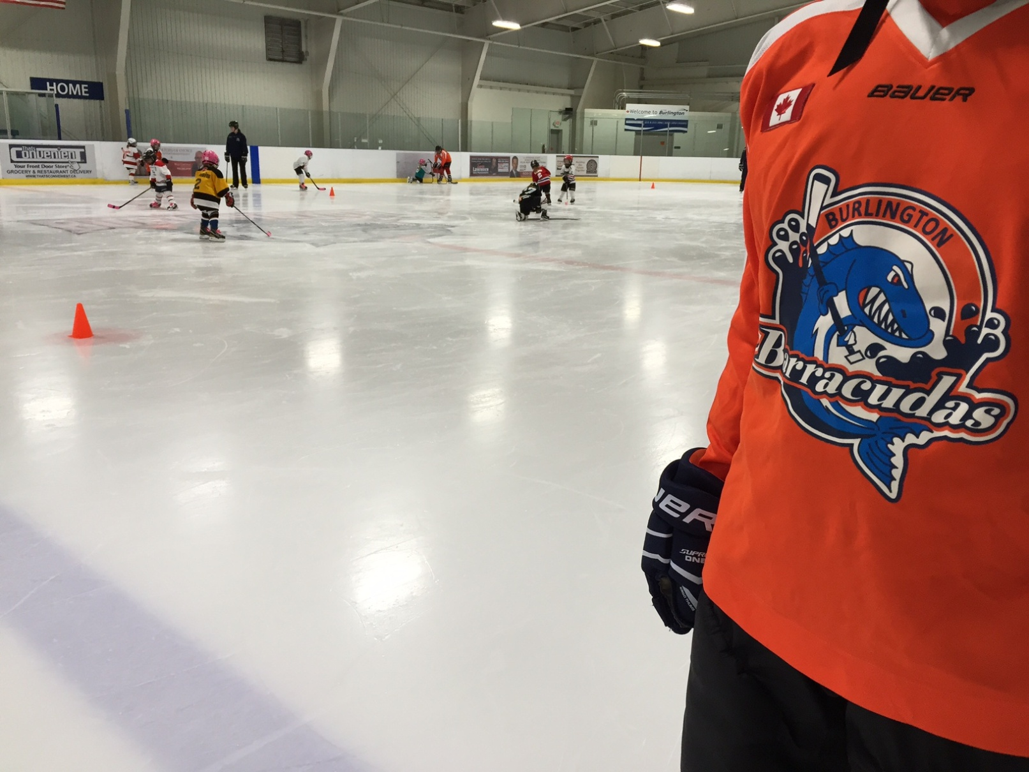
Communications
slkjklj
Jenn Wager – Director, Communications & Events
WE’RE SOCIAL!
@BGHC_News
@BGHC_News
Burlington Girls Hockey Club
bghc.ca
Send photos & video to Jenn communications@bghc.ca

Slide 21
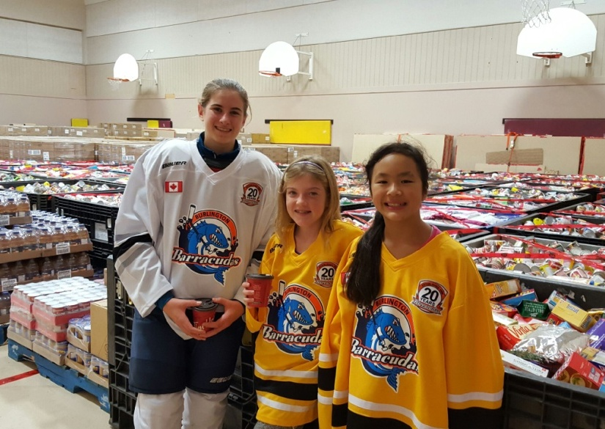
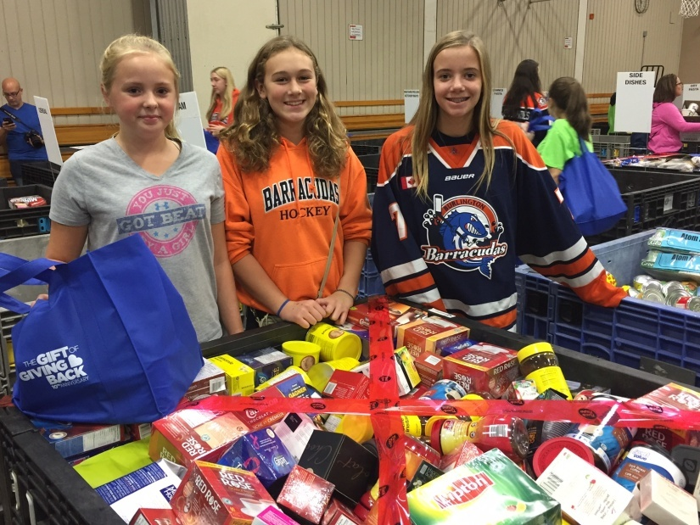
Community
The Gift of Giving Back is making real differences in the lives of those less fortunate in our community. Since 2005, our organization has accumulated over 3.4 million pounds of food since inception, with a direct local community benefit of over $8.6 million. The event supports, educates and empowers more than 2,000 young male and female hockey athletes and high school students to give back to our local community.
Date: TBA
Where: TBA
Each team needs a "Food Drive Captain" to coordinate food collection efforts!
Info - inquiries@giftofgivingback.ca
https://giftofgivingback.ca/who-we-are/burlington/

Slide 22
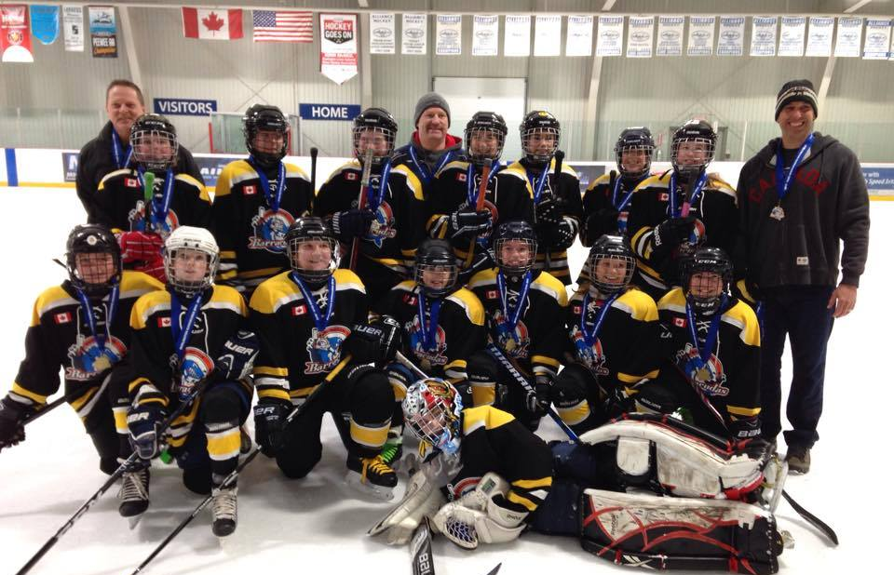
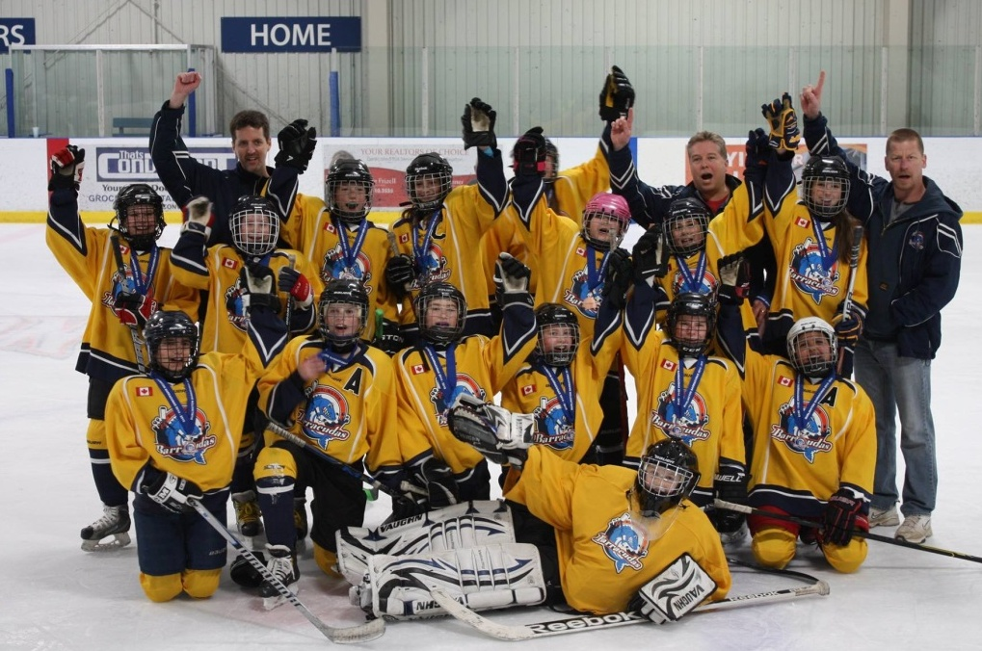
Thank You
James “You make a living by what you get. You make a life by what you give.” ~Winston Churchill

